Slide 1
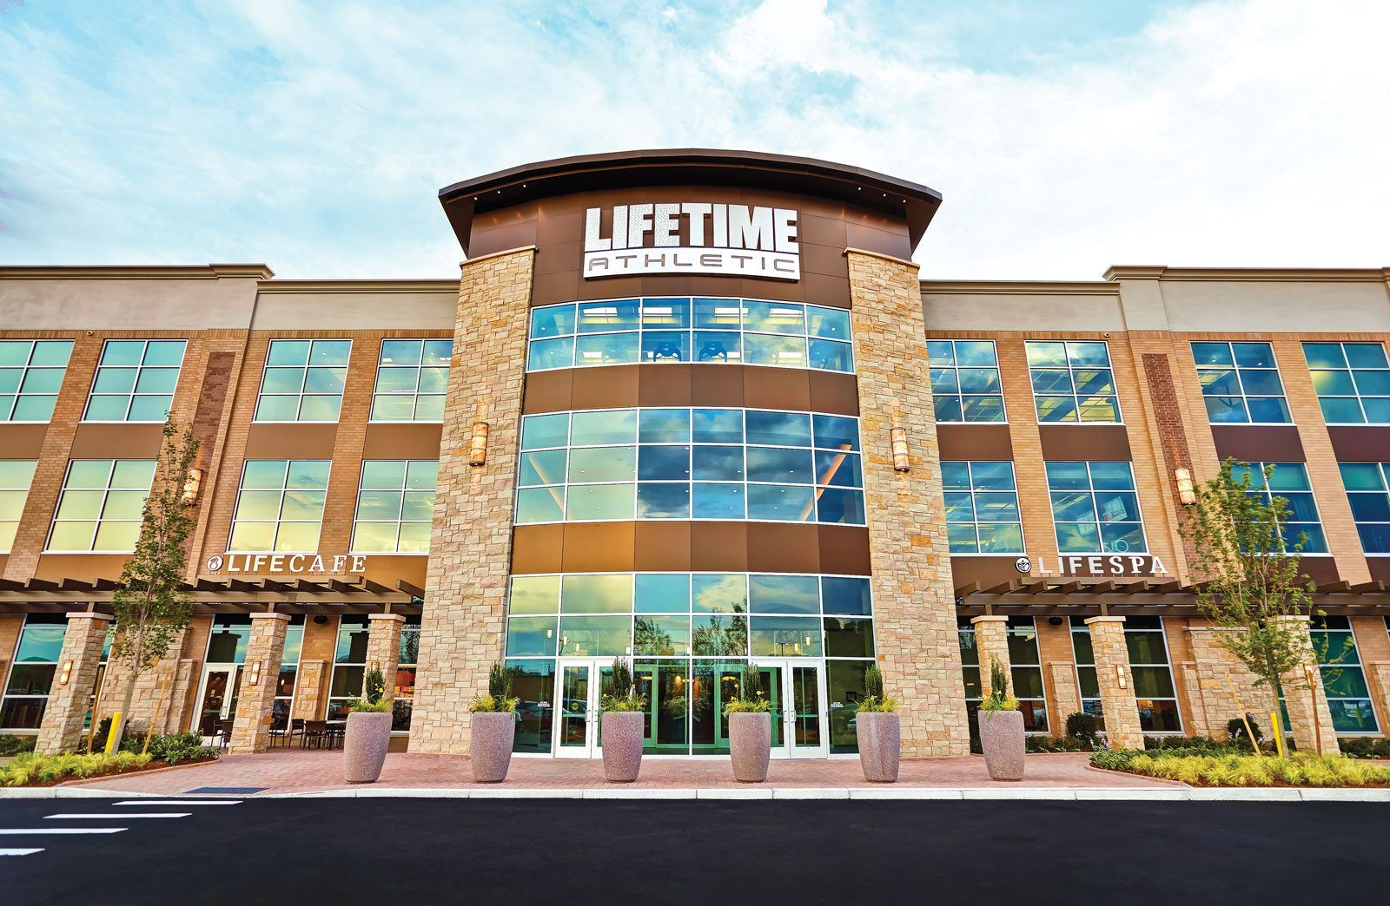
LIFETIME FITNESS INC. Cancellation Database
Relational Database

Slide 2
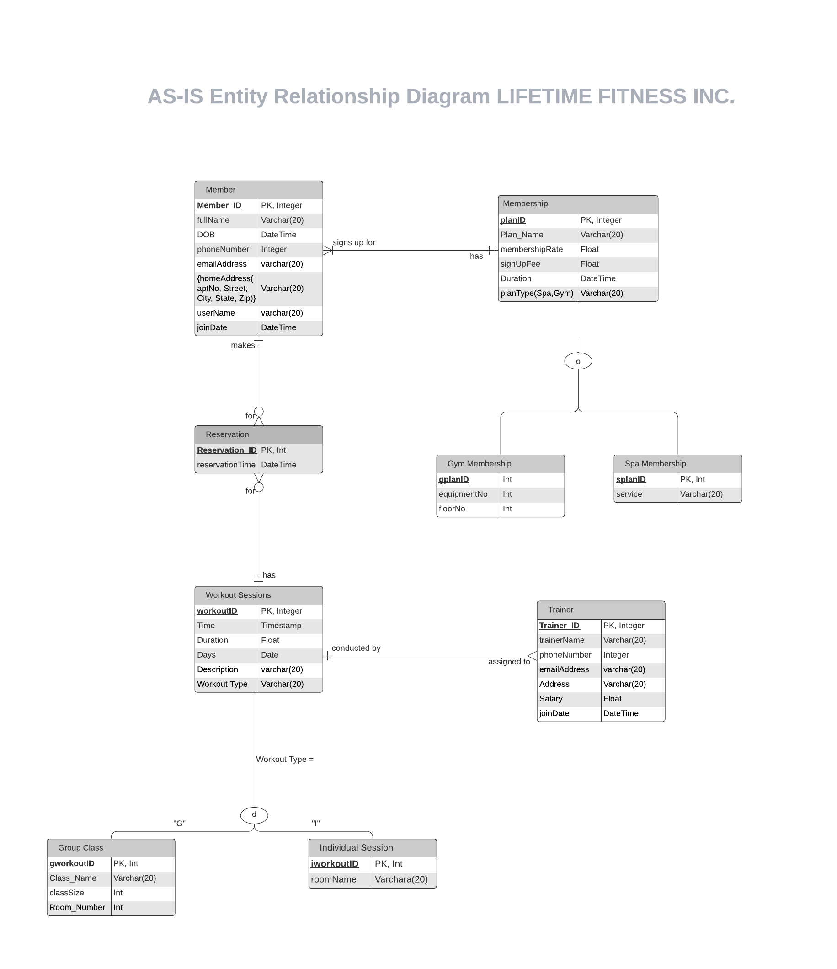
Section I - AS-IS ERD

Slide 3
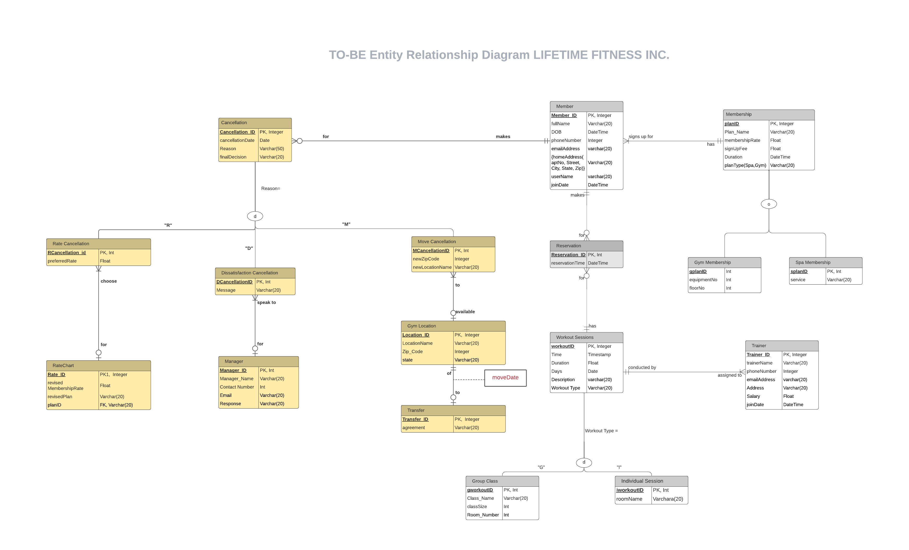
Section II – TO-BE Database (ERD)

Slide 4
Section II – Business Function to Data Entity Matrix

Slide 5
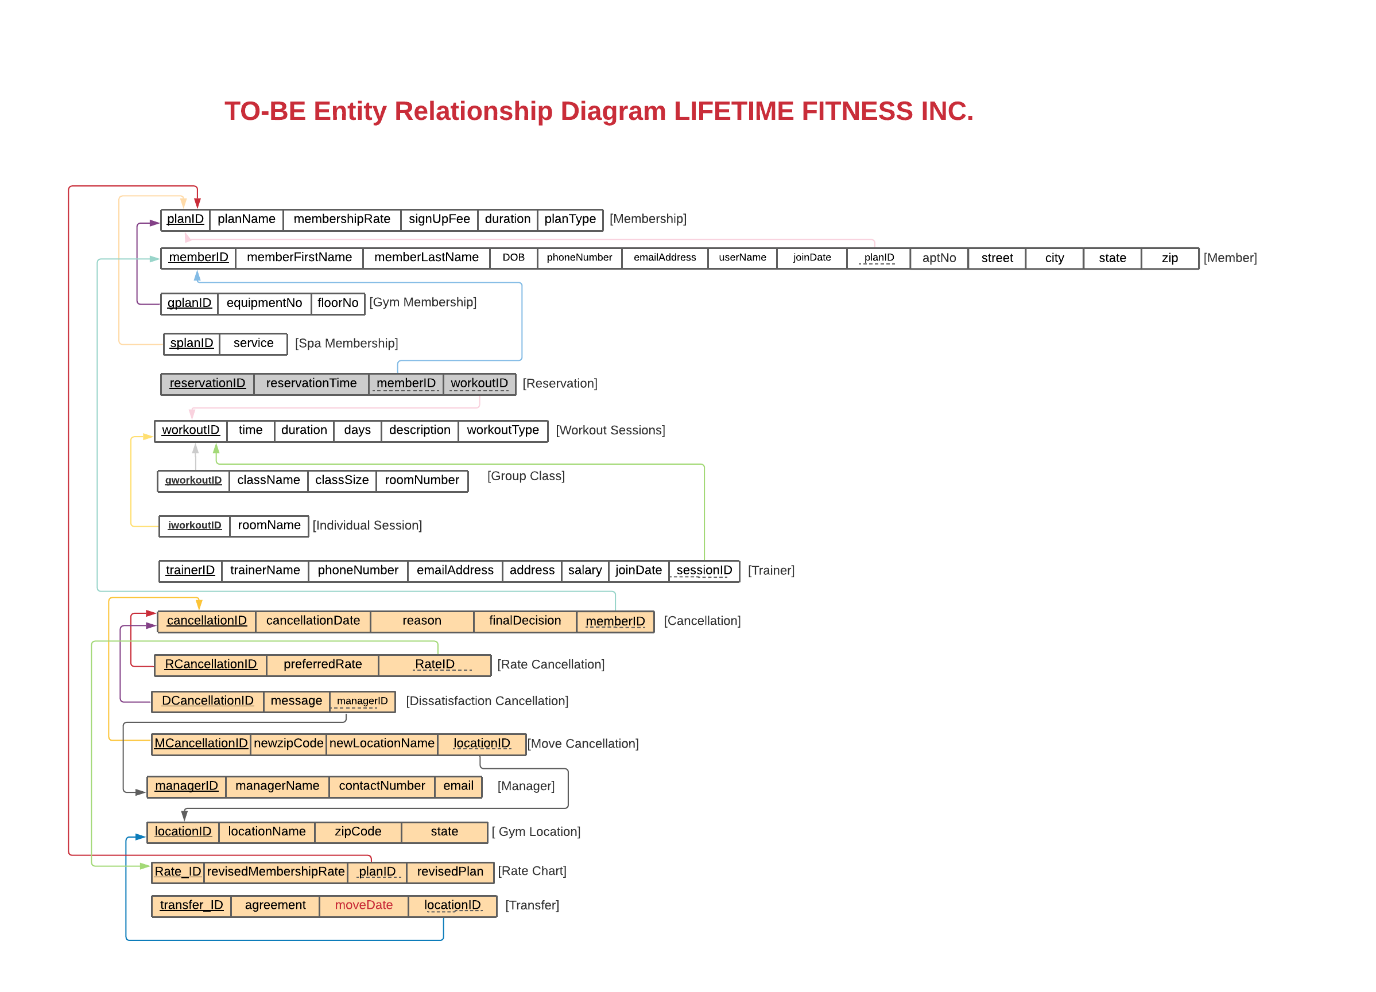
Section II – 3NF Relational Schema

Slide 6
Section III DATABASE IMPLEMENTATION

Slide 7
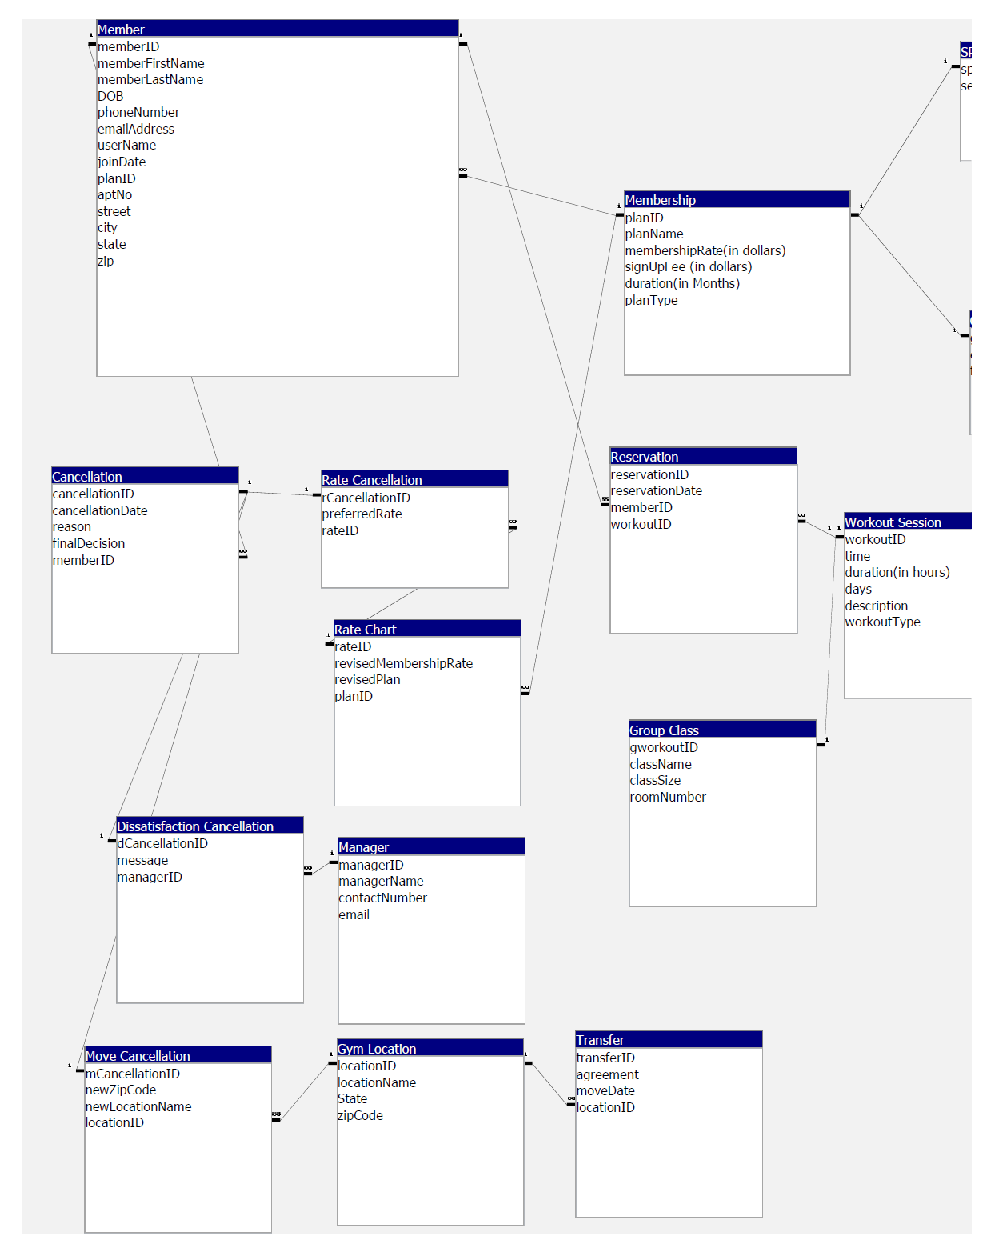
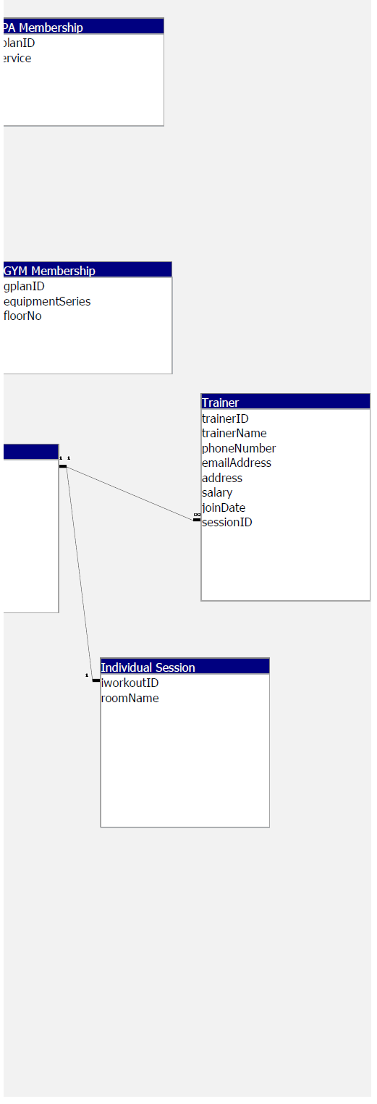

Slide 8
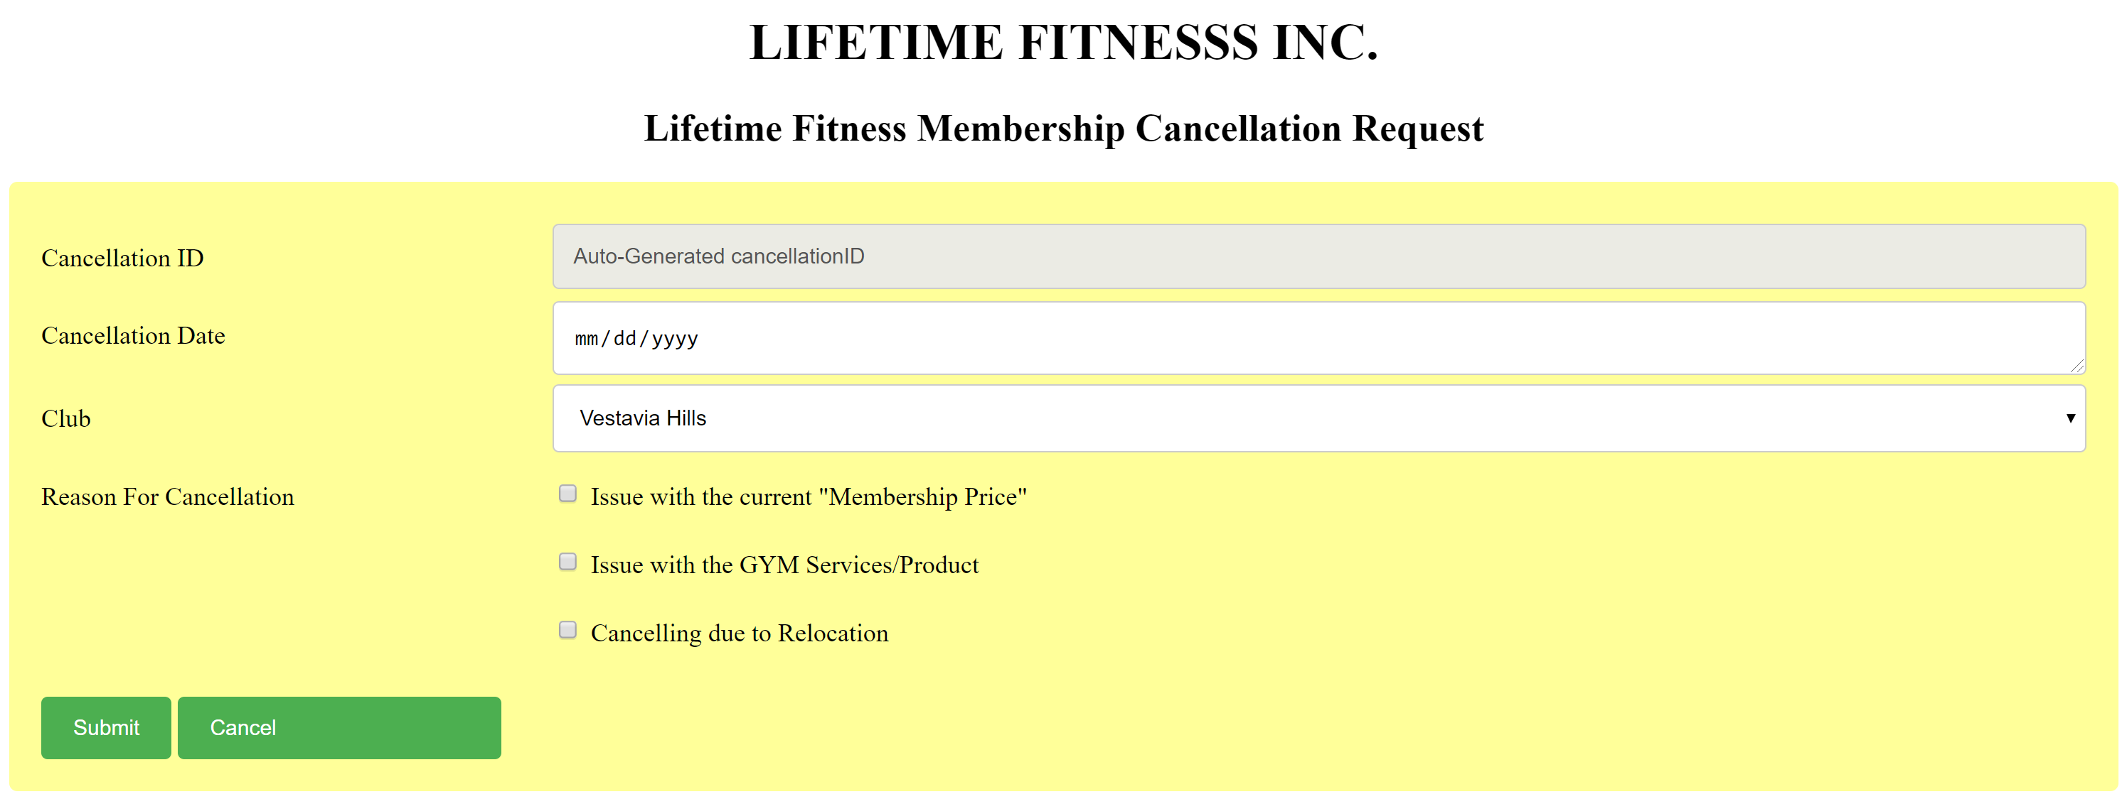
LIFETIME FITNESS MEMBERSHIP CANCELLATION FRAME DESIGN

Slide 9
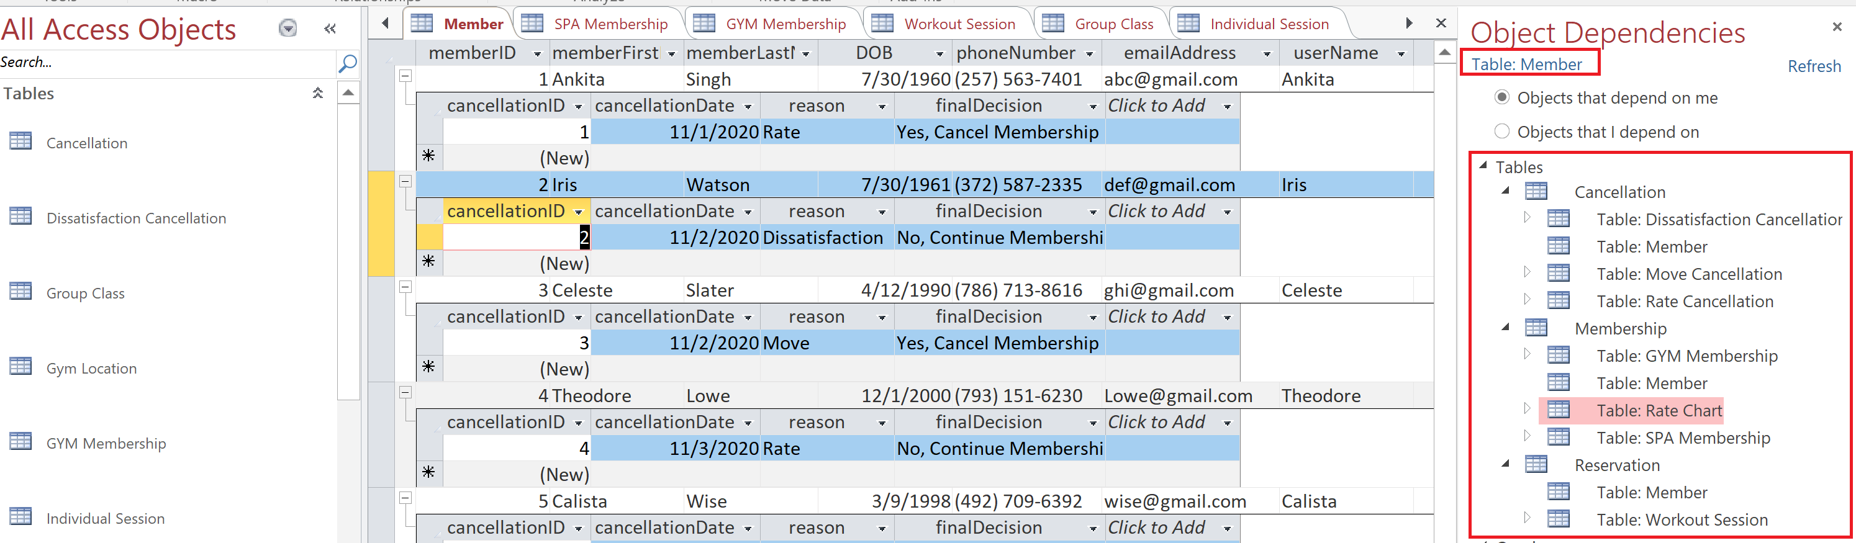
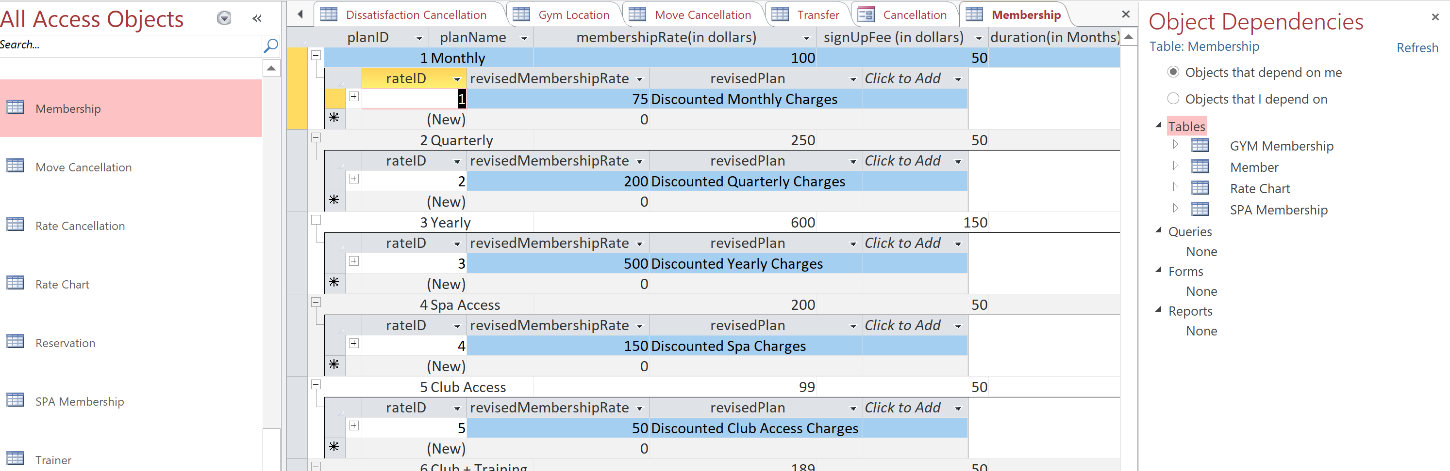
ACCESS DATABASE IMPLEMENTATION : OBJECT DEPENEDENCIES FOR MEMBER CANCELLATION PROCESS

Slide 10
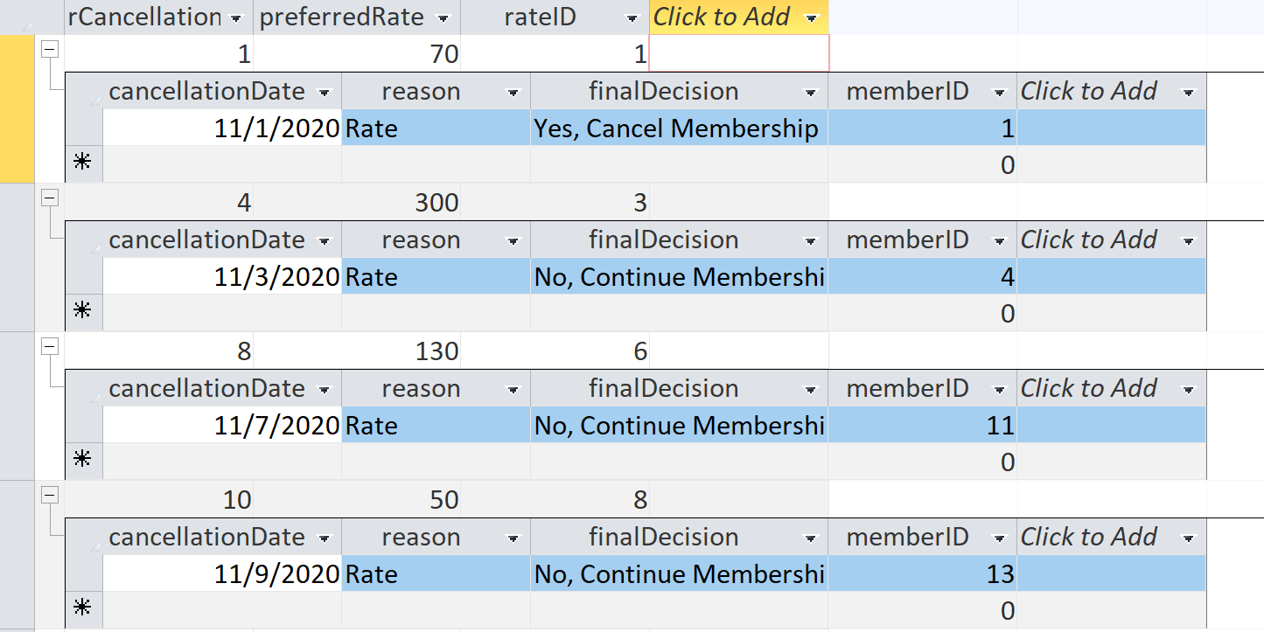
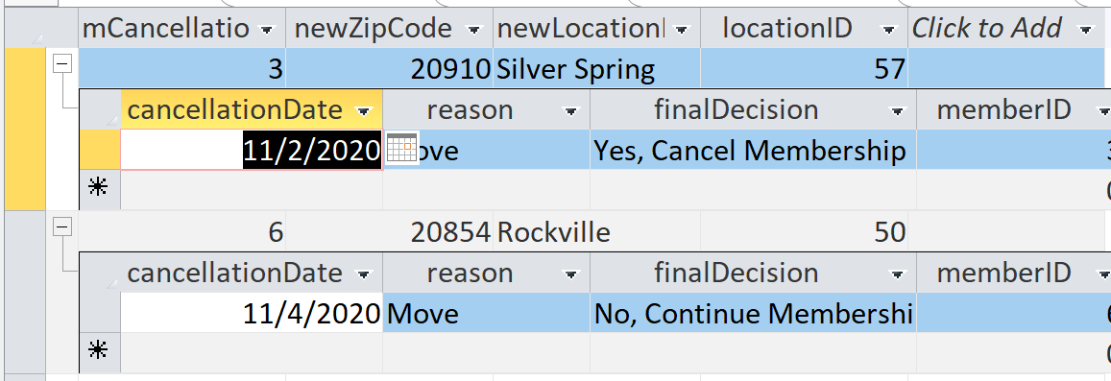
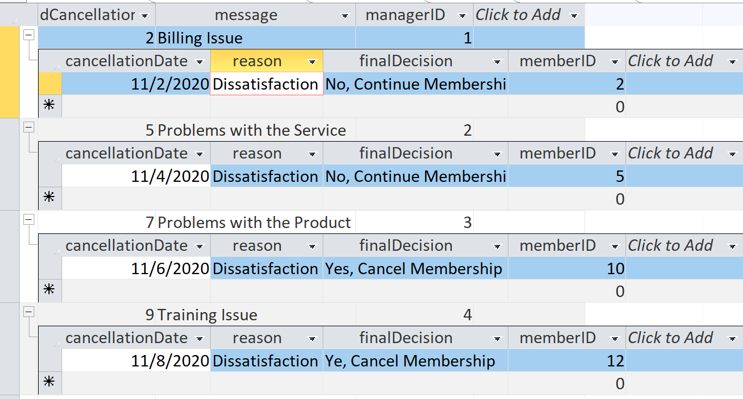
CANCELLATION REASONS: RATE/DISSATISFACTION/RELOCATION

Slide 11
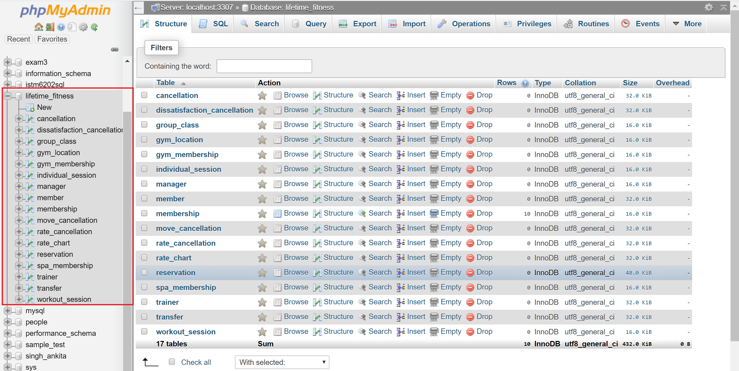
TABLES CREATED

Slide 12
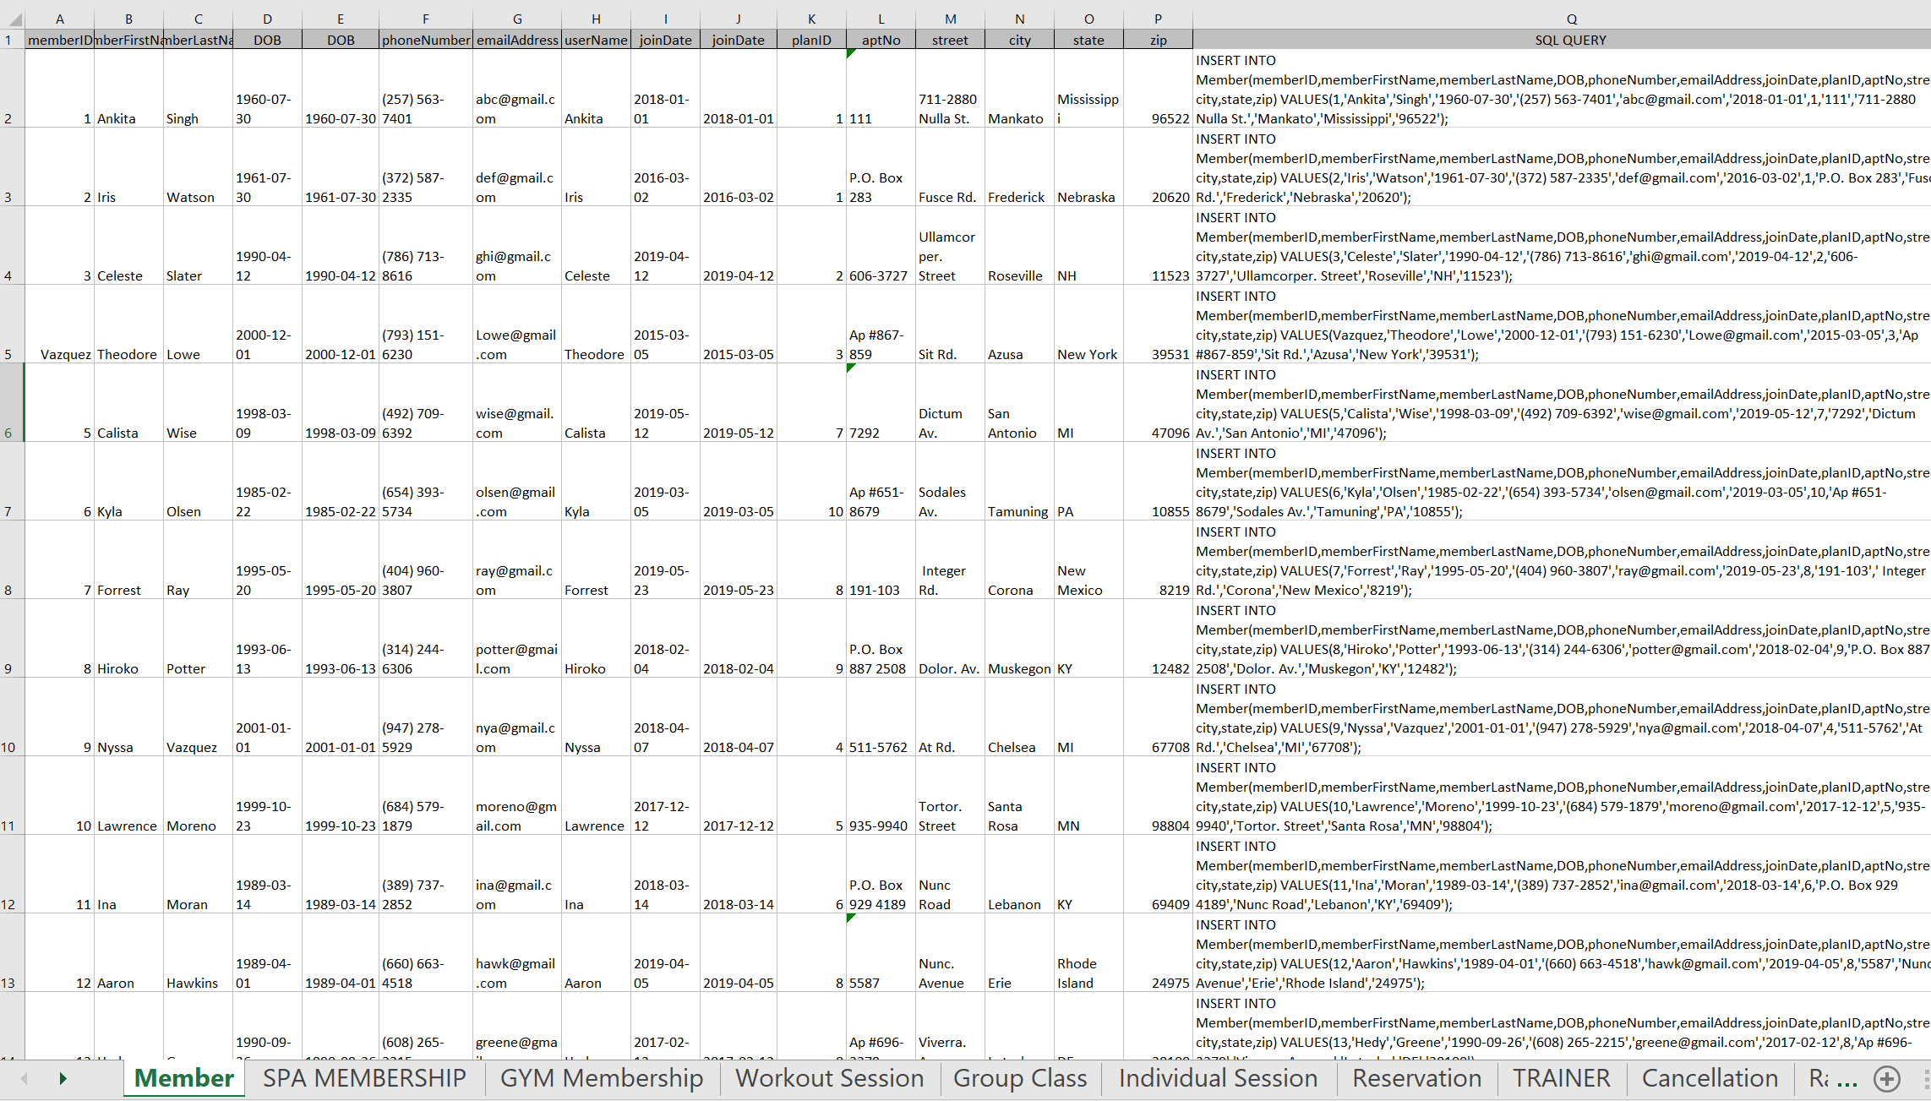
INSERTING DATA INTO LIFETIME_FITNESS DATABASE

Slide 13
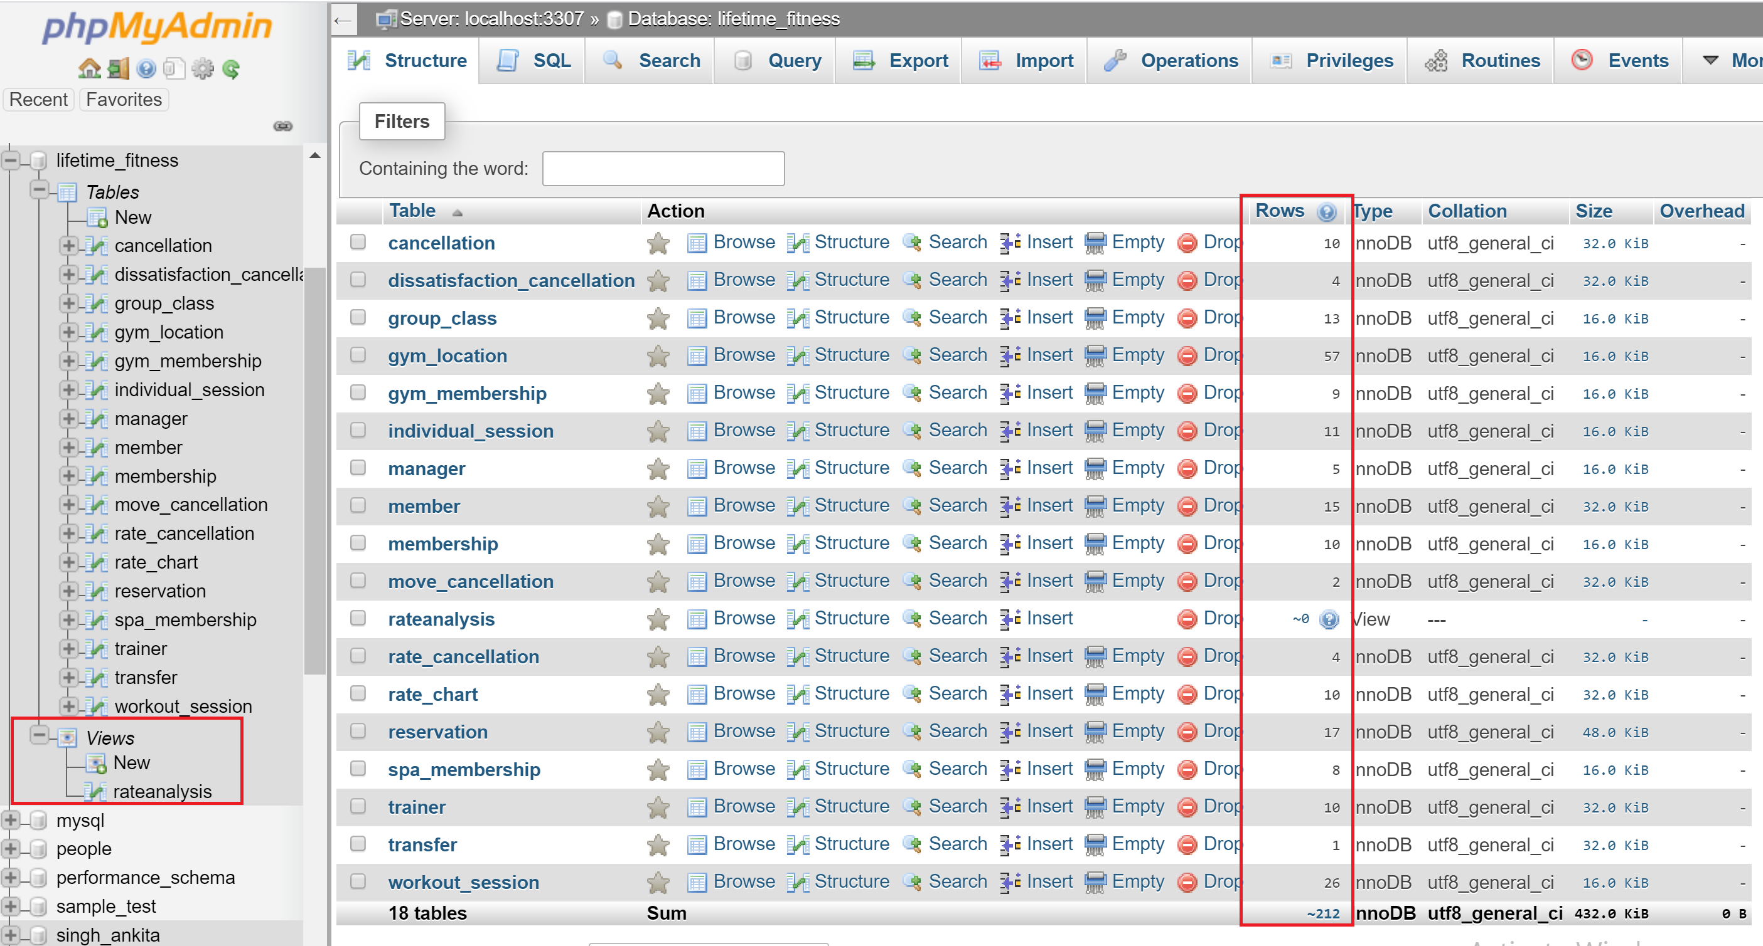
DATA INSERTED

Slide 14
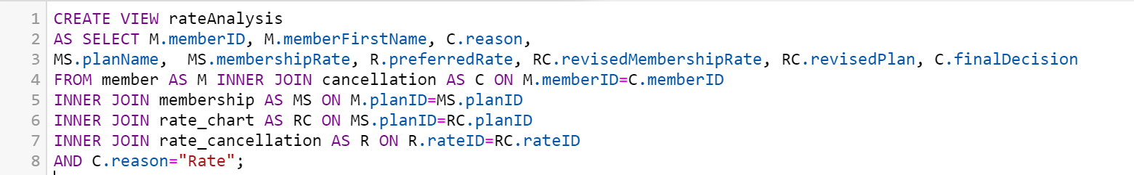
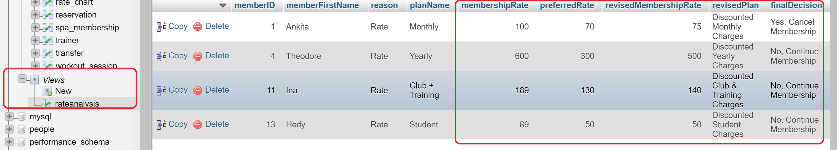
VIEW FOR CUSTOMER CHURN ANALYSIS

Slide 15
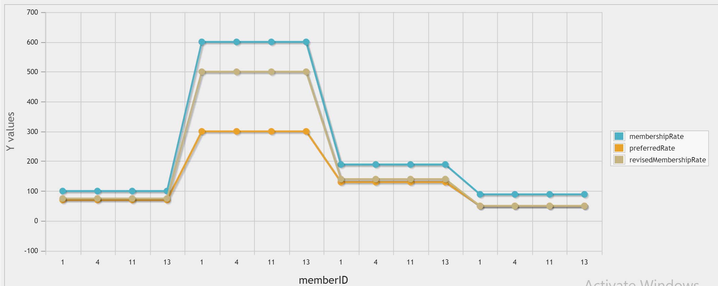
GRAPH PLOTTED WITH THE VIEW DATA

Slide 16
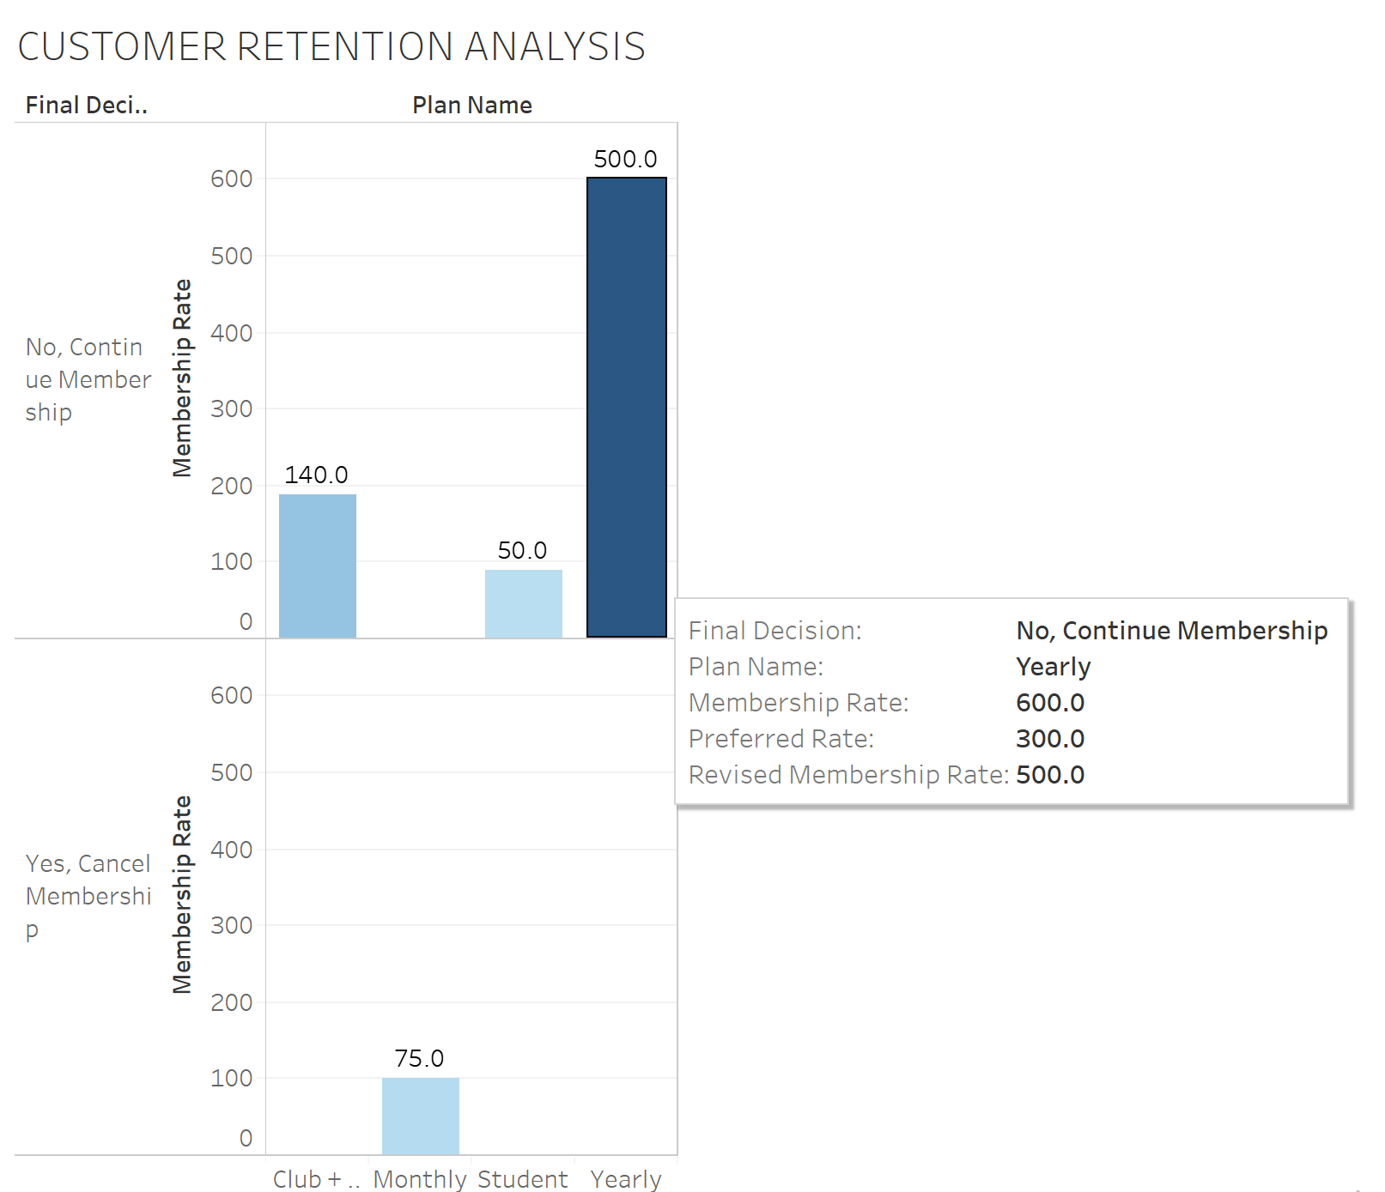
RATE ANALYSIS VIEW USED TO ANALYZE CUSTOMER CHURN RATE

Slide 17
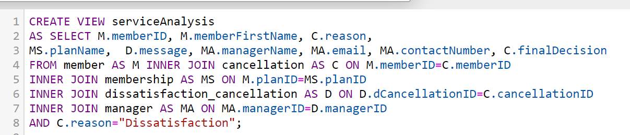
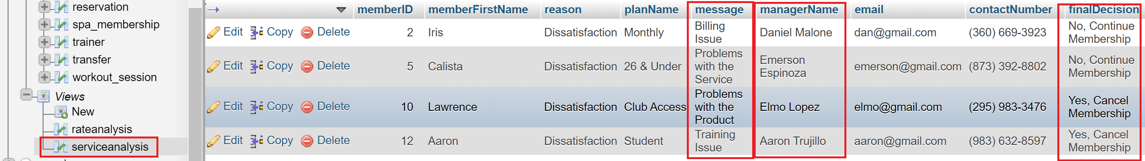
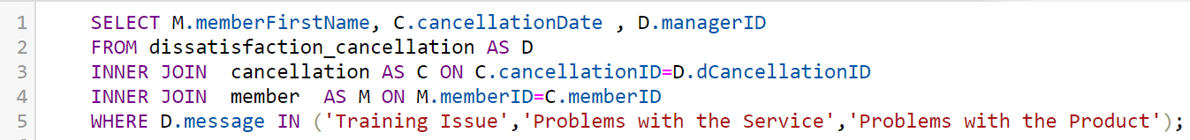
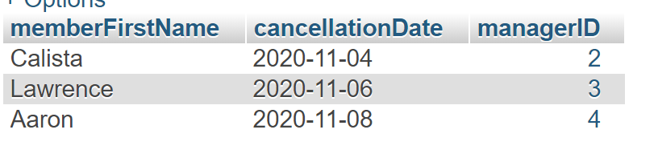
VIEW TO ANALYZE THE REASON FOR DISSATIFACTION AND MANAGER’s EFFECTIVENESS

Slide 18
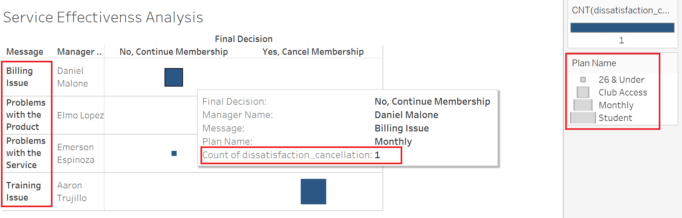
SERVICE ANALYSIS VIEW: TO IMPROVE BRAND MANAGEMENT AND SERVICE QUALITY

Slide 19
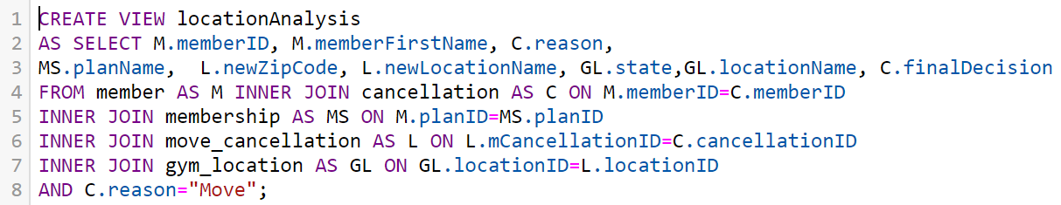
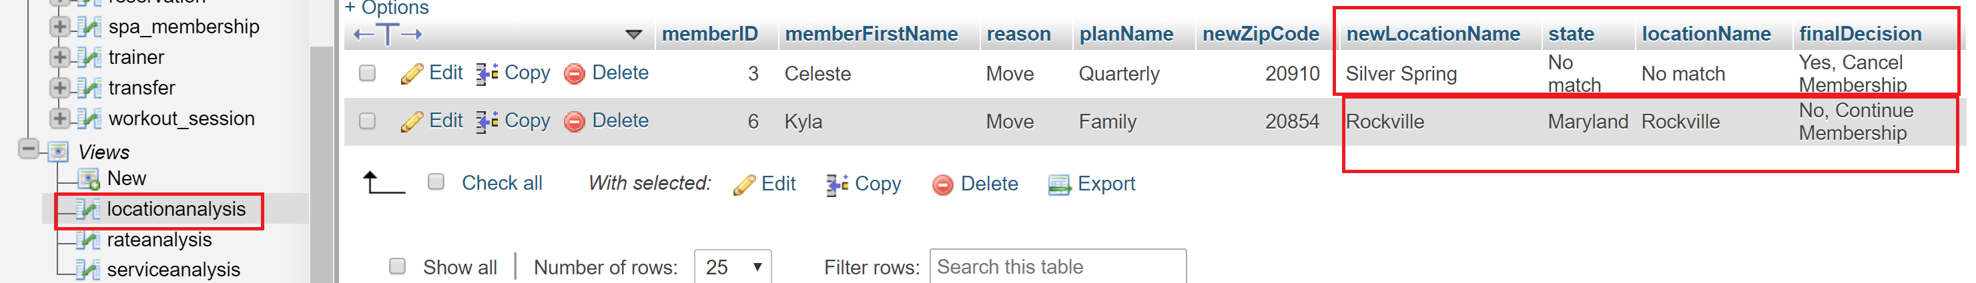
LOCATION ANALYSIS VIEW FOR IDENTIFYING OPPORTUNITIES TO INCREASE REVENUE

Slide 20
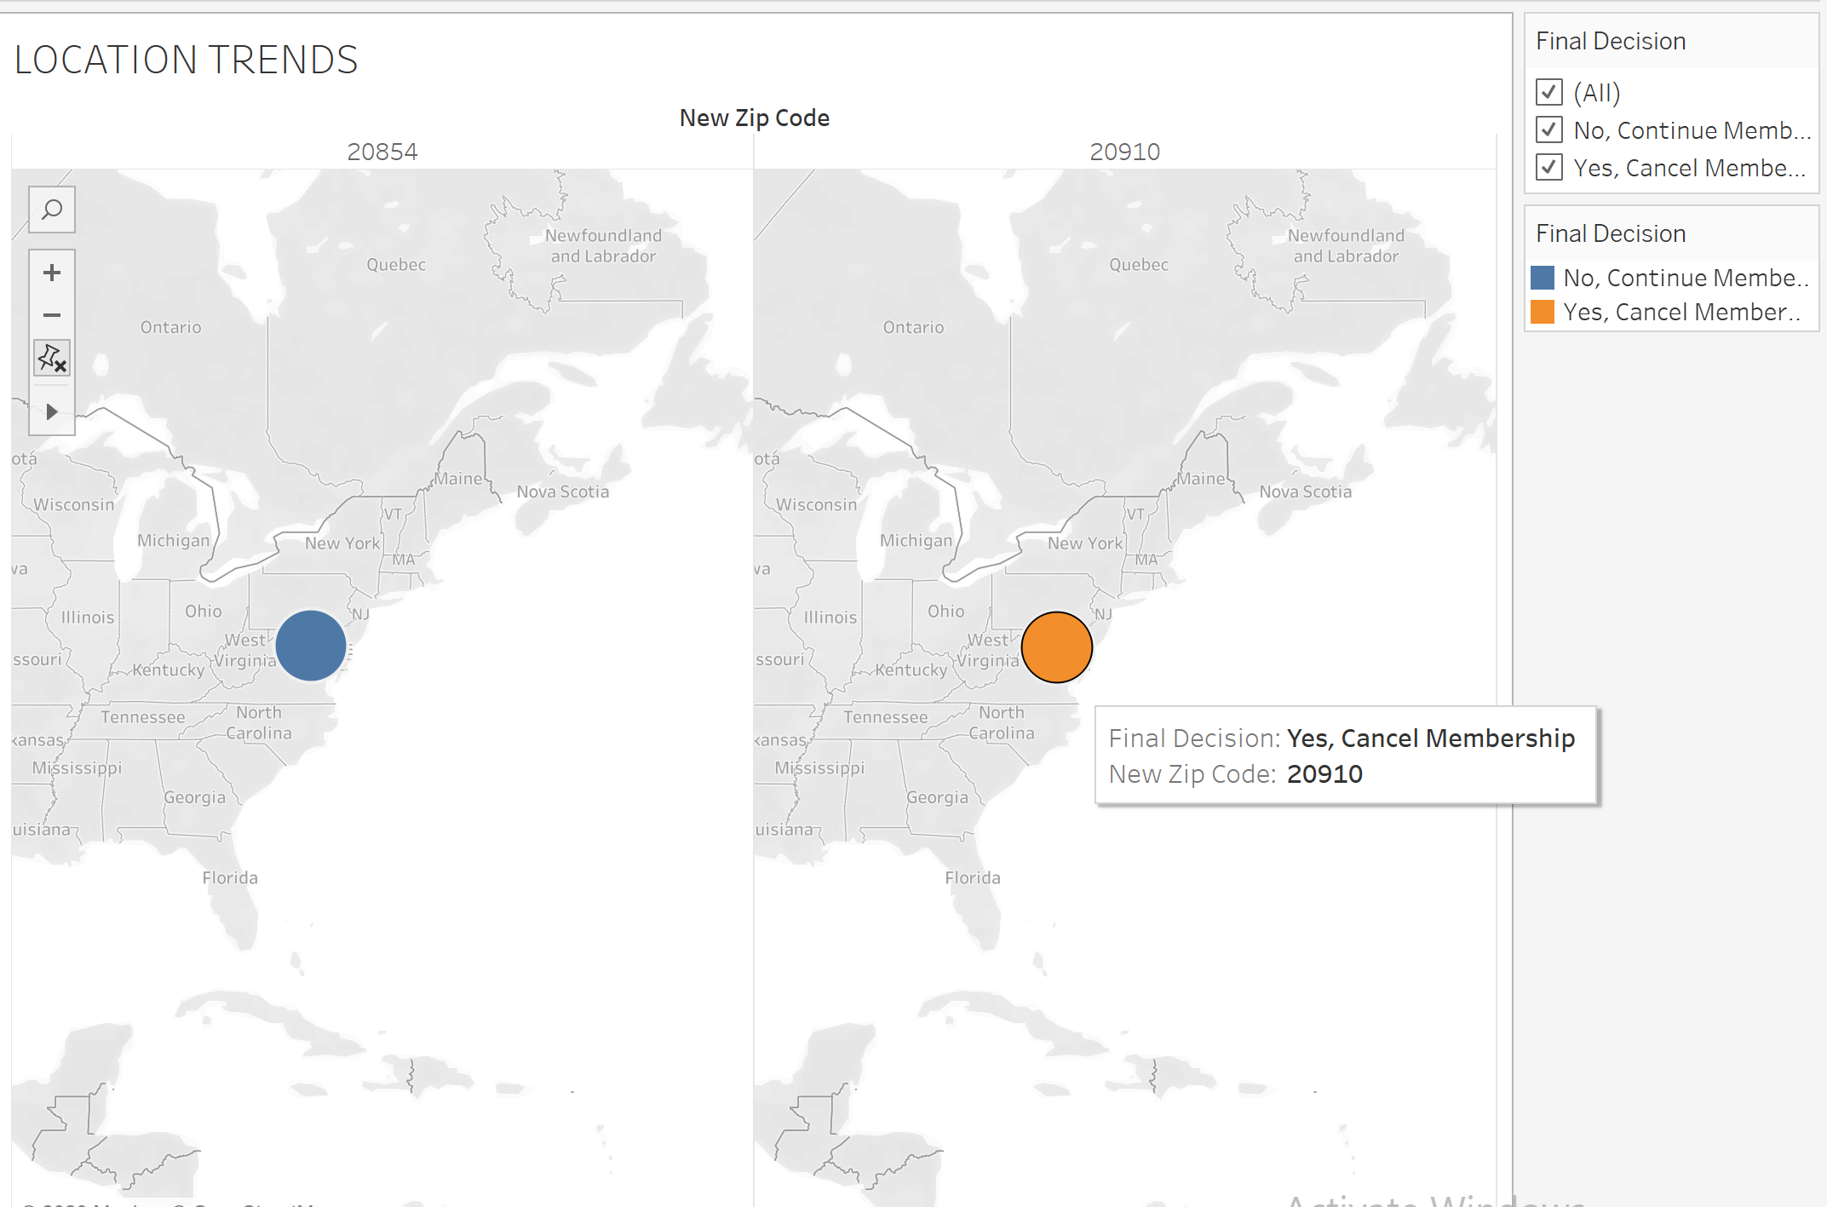
LOCATION ANALYSIS VIEW: RELOCATION TRENDS

Slide 21
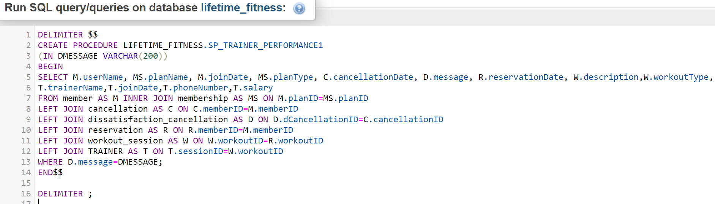
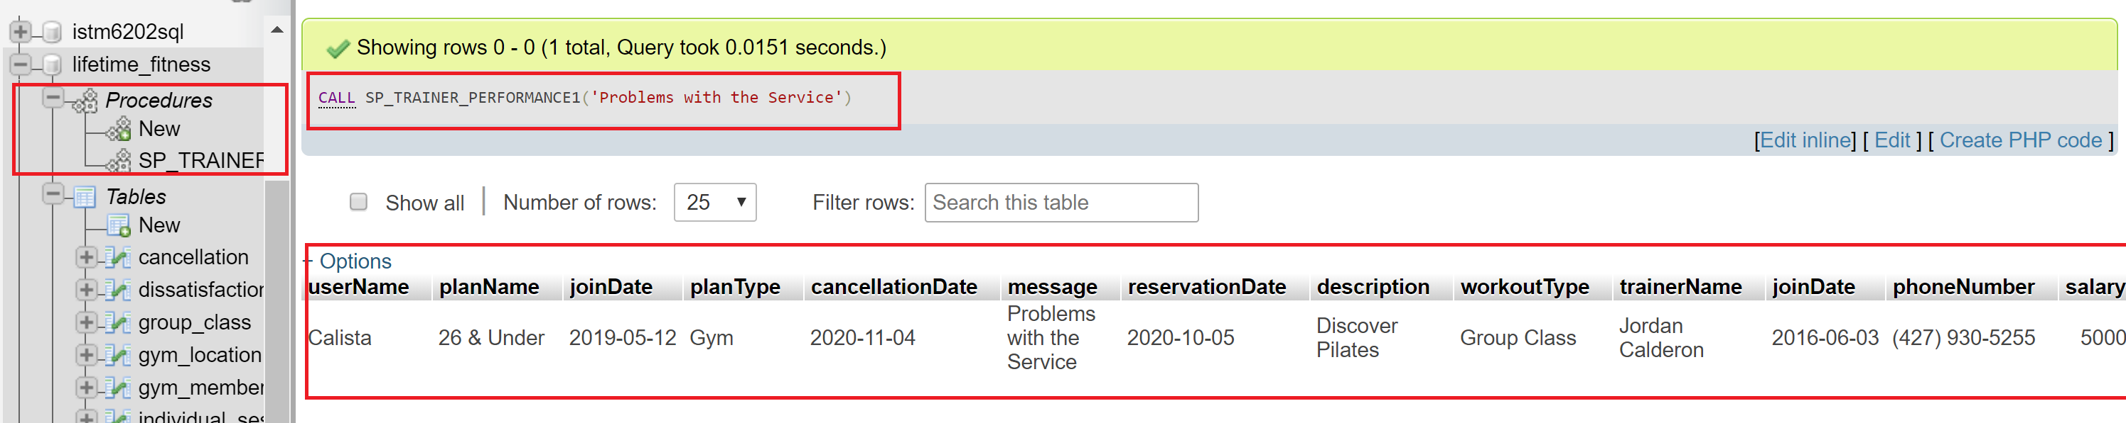
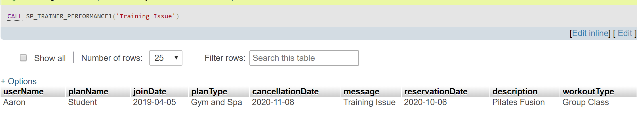
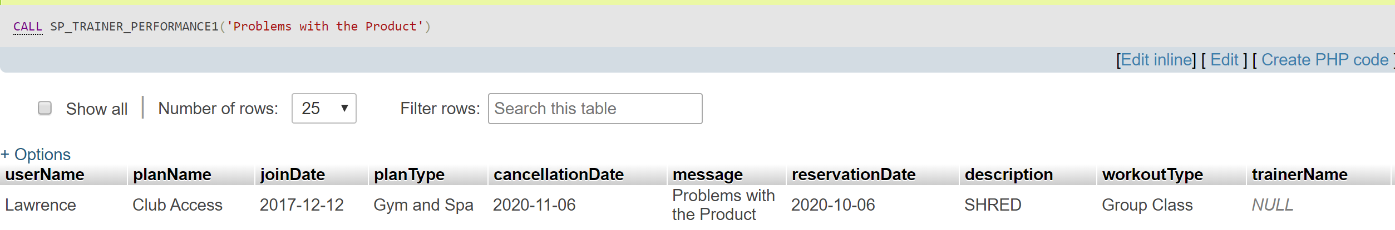
STORED PROCEDURE: GYM OPERATIONS PERFORMANCE ANALYSIS BASED ON MEMBER’s FEEDBACK

Slide 22
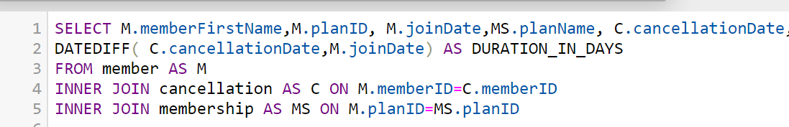
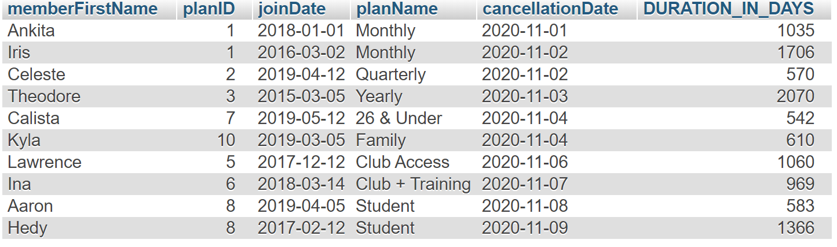
DURATION OF ASSOCIATION WITH THE GYM

Slide 23
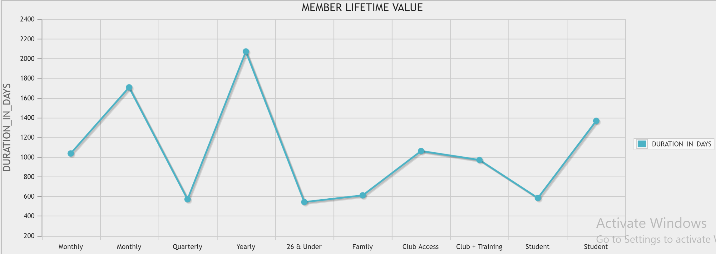
MEMBER LIFETIME VALUE(LCV)

Slide 24
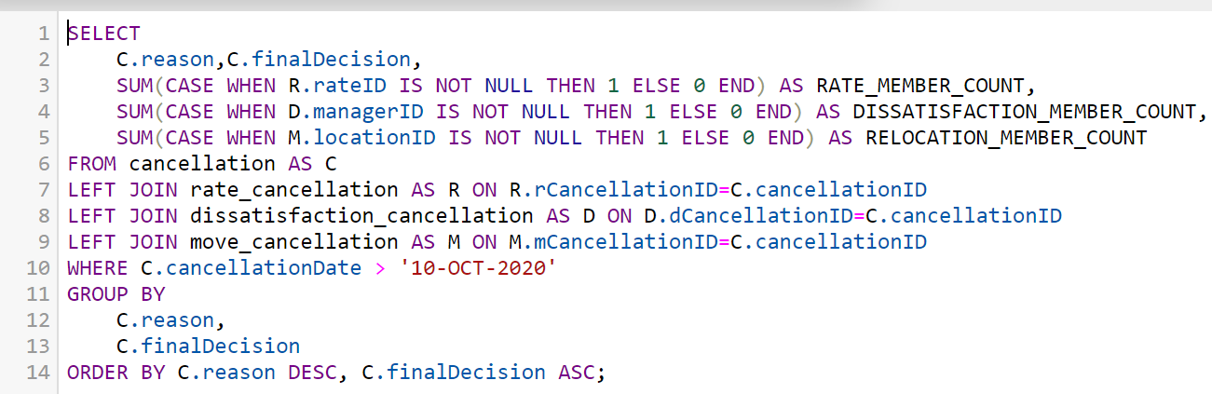
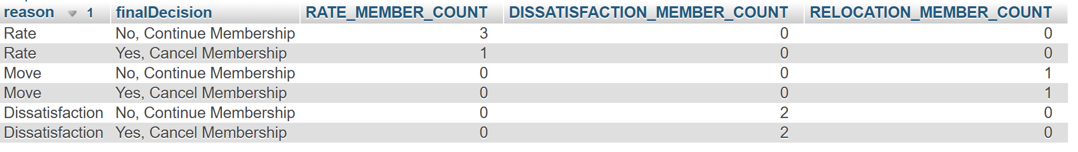
TOTAL COUNT OF GYM MEMBERS RETAINED & CHURNED GROUPED BY REASON OF CANCELLATION AND FINAL DECISION MADE

Slide 25
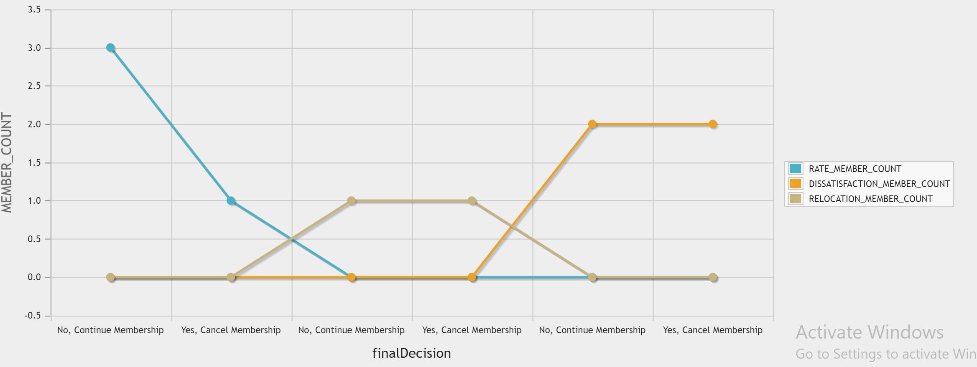
DATA VISUALIZATION- TOTAL COUNT OF MEMBERS TO MEASURE CHURN & RETENTION RATE GROUPED BY REASON OF CANCELLATON

Slide 26
Conclusion
Designing a mobile cancellation experience will provide many benefits
Improved customer satisfaction
Higher likelihood of member return to the club
Reduced overhead and operational expenses

